Slide 1
Title: Healdata (Webapp Name)
I2C2 - Ideathon
DATE: 7 November 2022
NAME: SARTHAK GARG
EMAIL: shibugarg0303@gmail.com
PHONE: 9368122660
College/Company: Punjab Engineering College , Chandigarh

Slide 2
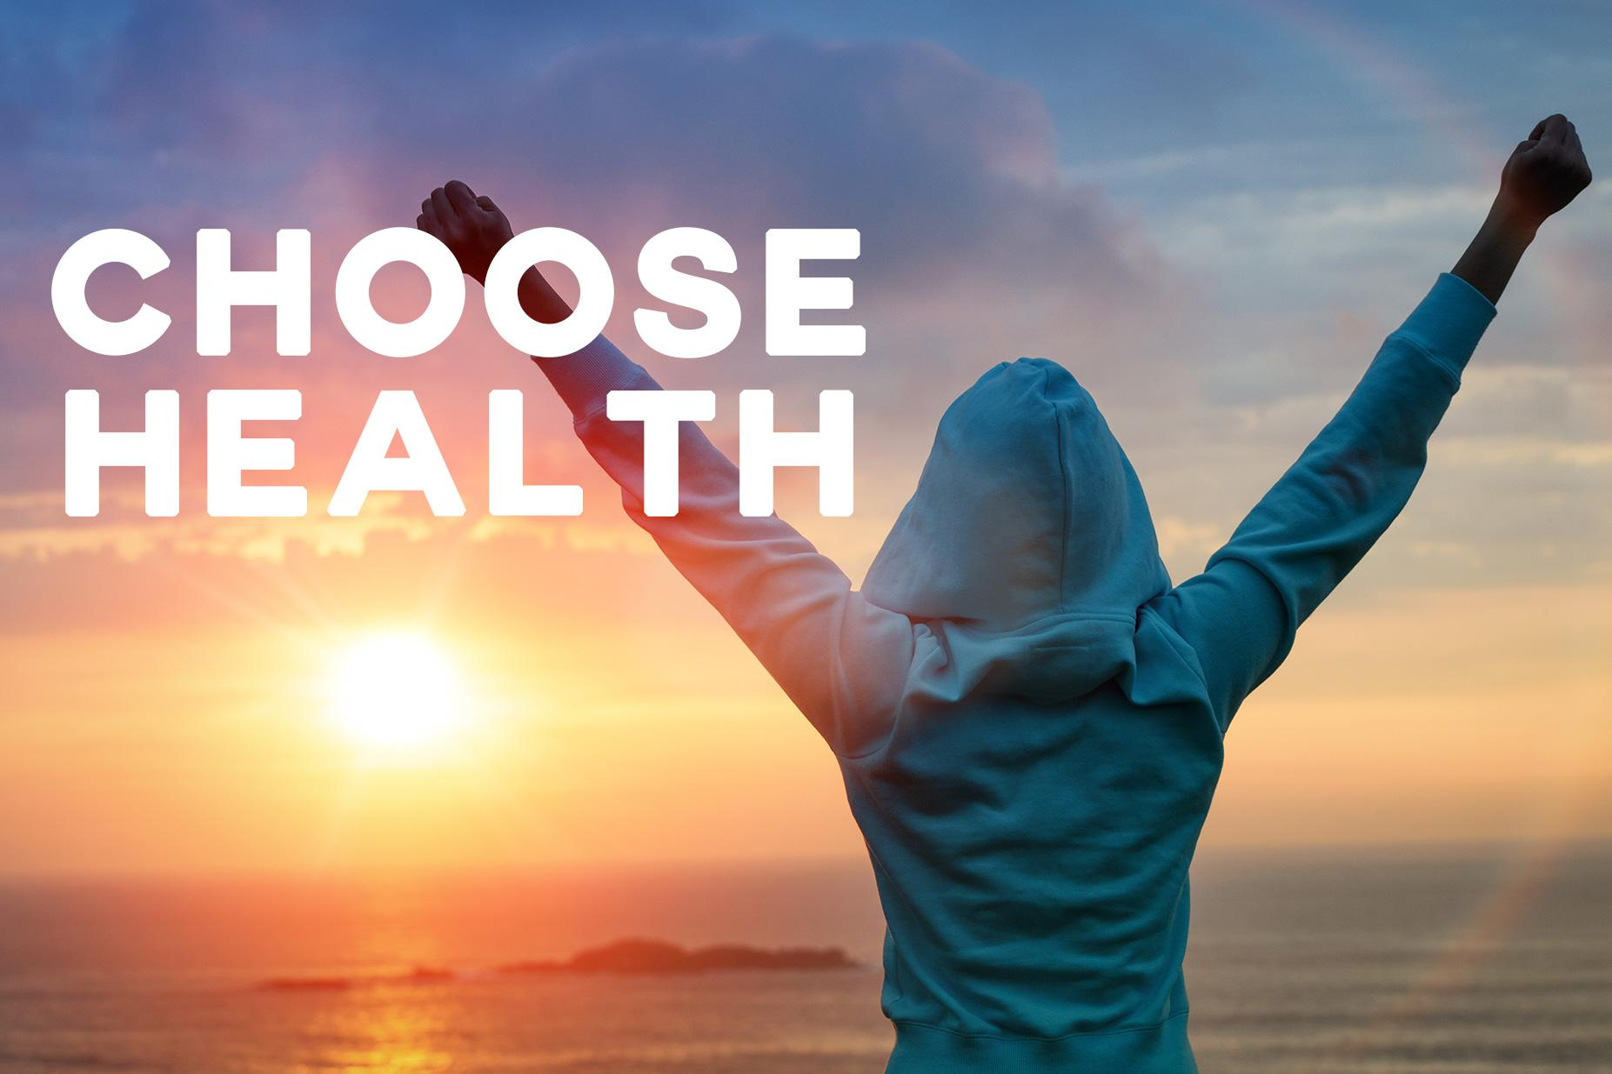
Theme Selected
I2C2 - Ideathon
Theme selected is Health!

Slide 3
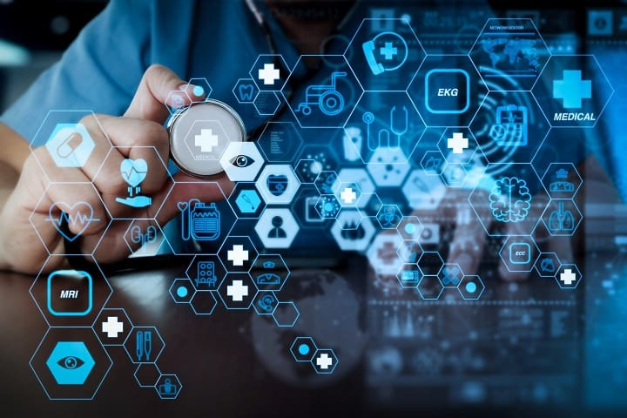
Problem Statement
I2C2 - Ideathon
I’m working on the problems related to health awareness among teenagers. Most important problem in health awareness is the lack of data. Either the data is not available of the health impacts due to various diseases and carelessness or data is not aggregated at one place.
For better health awareness , I believe that data is the first and foremost need. People believe on the proofs not just facts especially teenagers.

Slide 4
Idea/Solution
I2C2 - Ideathon
Describe the idea/solution that you have proposed for the problem statement ? ( Audience demographics included.)
I proposed the solution or idea for the problem is providing the entire health data of the entire world in the single website. As we all know if we require any health regarding data we need to crawl on multiple websites or articles, news to aggregate the entire data which can be most foremost thing in the awareness.
My webapp will provide one click solution for the entire health data of the world.
Example - If we require 2000-2022 data of cancer deaths, cured, new diagnosed every year , we might need to crawl over entire web for this data which might me cumbersome. So my website can be the solution for it.

Slide 5
Features
I2C2 - Ideathon
List down top features of your solution that will address the problems you have listed ?
Yearly data of every diseases of each country.
Total people cured, new diagnosed, total deaths every year in each country.
Interactive way of representing data in the form of graphs
People themselves can add the data if they find over the web
Future scope may includes :-
Data of every city, state, province( health data of each city,state,province)
With data some sort of awareness solutions can be provided at the website
Also one more major problem in health awareness is the social workers have lack of data where they need to actually provide the awareness(at the root level).

Slide 6
Customer Segments & Market Size
I2C2 - Ideathon
For whom are you creating value for? If relevant, segment customers based on needs/ behaviours/ other traits.
I created this website for entire population of the world. As delivering entire health data on single website is the main viable thing of my project , so it is targeting the entire population.
What are the market sizes?
Market size is huge as today, everyone wants everything under the one roof and just by one click. So my webapp is one click solution for all those searching for health data of entire world.

Slide 7
Technical Aspect
I2C2 - Ideathon
Briefly, explain your technical stack & approach ?
Manually edit the health data into database APIs using Node JS
Fetch Api to fetch data Frontend in ReactJS
React plotly for graphs Form to give info of health

Slide 8
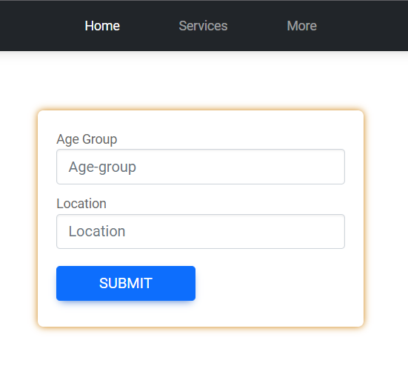
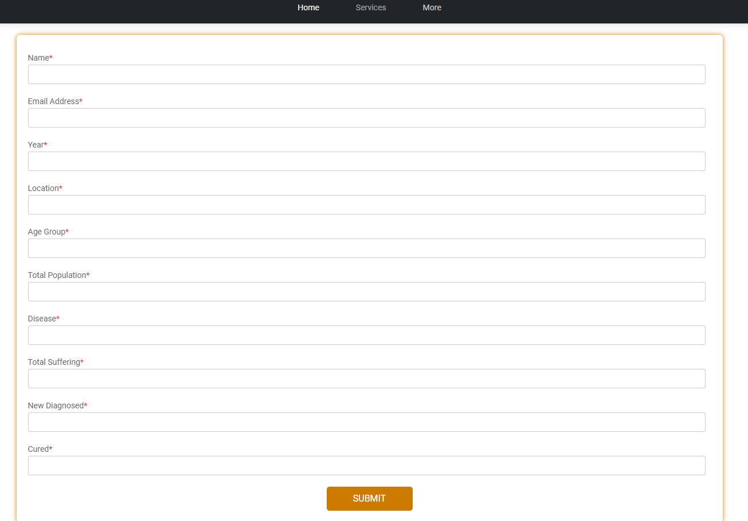
Insides of the Healdata
Homepage
Form page

Slide 9
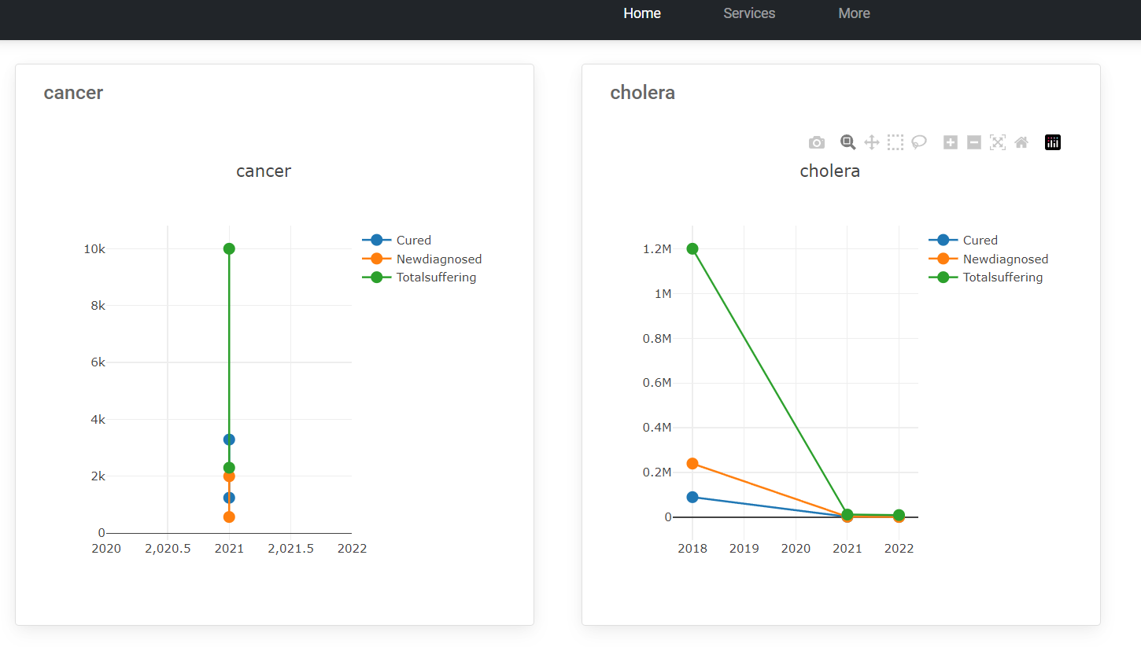
Health data page
**Data in page is just for showing purpose and not actual data

Slide 10
Unique Value proposition
I2C2 - Ideathon
What are the key benefits your product/service will provide to customers?
Health data of the world
Normal people can update the data
Interactive way of presenting the data
Instant and correct data
Powerful website

Slide 11
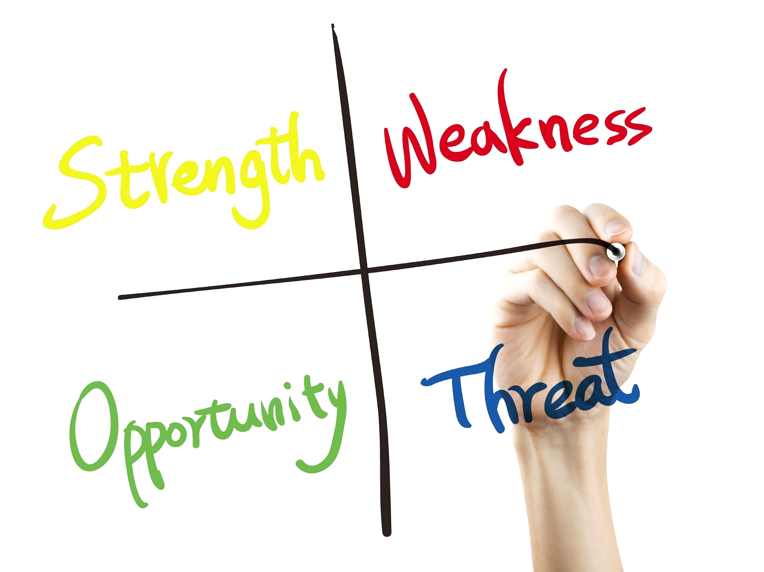
SWOT Analysis
I2C2 - Ideathon
Mention the SWOT analysis of your idea/solution ?
Strengths - Highly distributed data is aggregated at one place
Weakness - Difficult to aggregate such huge data correctly
Opportunities - This huge data helps in predicting the trends of health of any area and accordingly take actions
Threats - Lack of data

Slide 12
Why do you think this solution will work ?
I2C2 - Ideathon
This solution will work because my website is aggregating the entire data of every country, every age group and every year and presenting it in very interactive way. I believe that any social worker can now easily access the health data of entire world and make its awareness program much more successful. Even if teenagers directly visits this website the interactive data present over it may sow a seed of health awareness among them.

Slide 13
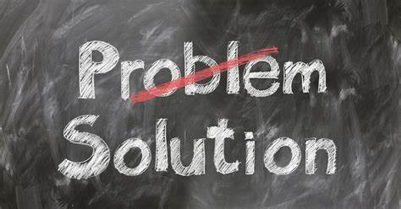
Problems you faced while making this project/idea/solution and how you overcame it ?
I2C2 - Ideathon
Collecting data manually
Just learned React Js so it was difficult to apply react tools.
As i’m dealing with huge data, so definitely i need to make my webapp asynchronous so the users won’t face any kind of inconvenience.
Database used is MySQL. Data fetched needs to be filtered and converted to JSON format.
Deciding which library/framework should be used to produce graphs in website
Responsiveness of website is another big problems

Slide 14
How do you look forward on improving the idea/solution ?
I2C2 - Ideathon
Adding much more graphs and columns to more detailed health data
Using web scraping or some kind of automation to automatically insert the data
Adding security feature to check the details entered in form are valid and correct.
Adding services feature to the website
Improving GUI.
Adding feature of only choosing those locations,age groups which are present in database.
Adding data of every state,province, state and areas.
Can also send data in the form of Apis if any organisation requires.

Slide 15
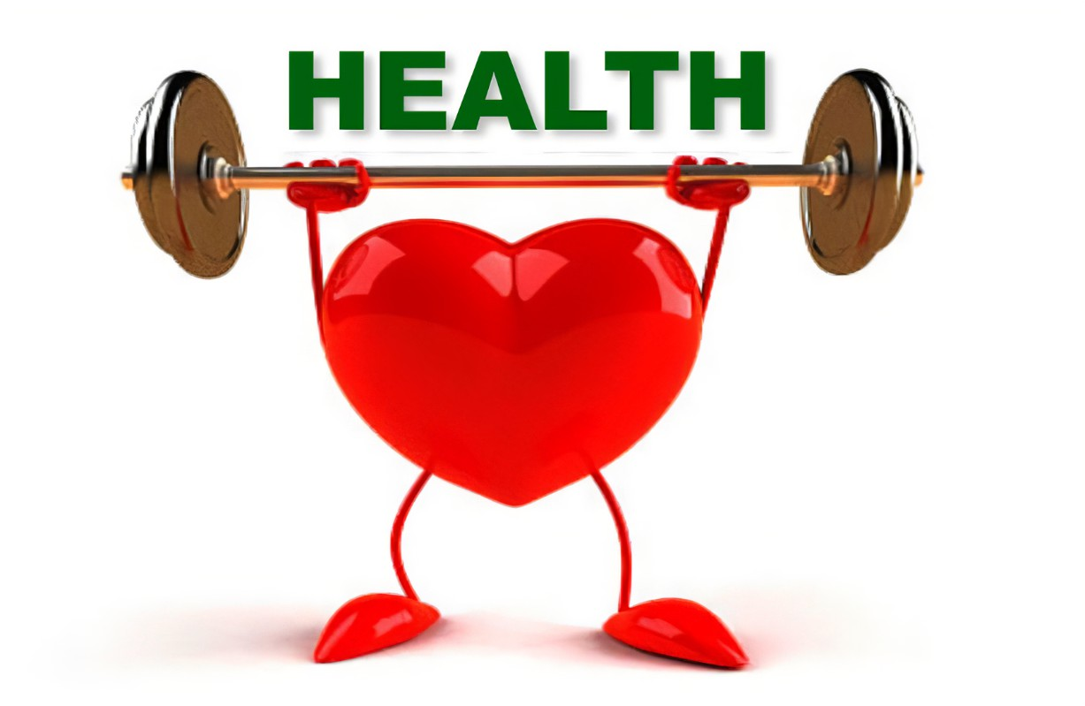
Conclusion
I2C2 - Ideathon
Describe in detail.
This webapp can be highly successful as no such type is present on the web. This the first webapp of it's type and can be highly successful and is of great need.
Improvements are definitely required and welcome.

Slide 16
Thankyou
I2C2 - Ideathon

